Slide 1
SOTWARE TESTING (CS-497)
Course Instructor: AMIR IMAM

Slide 2
Syllabus Chapter 3
Test– Planning and Design
Static Testing
Static Analysis
Control flow
Static Analysis by tools
Reviews
Formal
Informal
Inspections
Walkthroughs

Slide 3
What is test design technique?
Test Design is creating a set of inputs for given software that will provide a set of expected outputs.
Broadly speaking there are two main categories of Test Design Techniques. They are:
Static Techniques
Dynamic Techniques

Slide 4
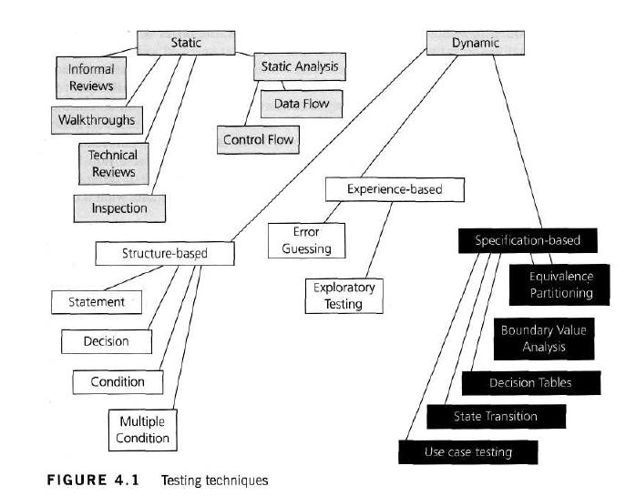

Slide 5
What is a static test technique?
Static testing is the testing of the software work products manually, or with a set of tools, but they are not executed.
It starts early in the Life cycle and so it is done during the verification process.
The primary objective of static testing is to improve the quality of software products by assisting engineers to recognize and fix their own defects early in the software development process.
Because of Static testing those errors uncover which are unable to find in dynamic testing.
It does not need computer as the testing of program is done without executing the program. For example: reviewing, walk through, inspection, etc.

Slide 6
What are the uses of Static Testing?
The uses of static testing are as follows:
Since static testing can start early in the life cycle so early feedback on quality issues can be established.
As the defects are getting detected at an early stage so the rework cost most often relatively low.
Development productivity is likely to increase because of the less rework effort.
Types of the defects that are easier to find during the static testing are: deviation from standards, missing requirements, design defects, non-maintainable code and inconsistent interface specifications.

Slide 8
What is Informal reviews?
Informal reviews are applied many times during the early stages of the life cycle of the document.
A two person team can conduct an informal review.
In later stages these reviews often involve more people and a meeting.
The goal is to keep the author and to improve the quality of the document.
The most important thing to keep in mind about the informal reviews is that they are not documented.

Slide 9

What is Formal review?
Formal reviews follow a formal process. It is well structured and regulated.
A formal review process consists of six main steps:
Planning
Kick-off
Preparation
Review meeting
Rework
Follow-up

Slide 10
Formal Review
1. Planning: In this phase the review process begins with a request for review by the author to the moderator (or inspection leader).
A moderator has to take care of the scheduling like date, time, place and invitation of the review.
For the formal reviews the moderator performs the entry check and also defines the formal exit criteria.
The entry check is done to ensure that the reviewer’s time is not wasted on a document that is not ready for review. So, the entry criteria are to check that whether the document is ready to enter the formal review process or not.
Once, the document clear the entry check the moderator and author decides that which part of the document is to be reviewed.
Since the human mind can understand only a limited set of pages at one time so in a review the maximum size is between 10 and 20 pages.

Slide 11
Formal Review
2. Kick-off:
The goal of this step is to give a short introduction on the objectives of the review and the documents to everyone in the meeting.
The relationships between the document under review and the other documents are also explained, especially if the numbers of related documents are high.
By performing Kick-off, it has been observed that up to 70% more major defects found per page.

Slide 12
Formal Review
3. Preparation:
In this step the reviewers review the document individually using the related documents, procedures, rules and checklists provided.
Each participant while reviewing individually identifies the defects, questions and comments according to their understanding of the document and role.
After that all issues are recorded using a logging form.
The success factor for a thorough preparation is the number of pages checked per hour(checking rate). Usually the checking rate is in the range of 5 to 10 pages per hour.

Slide 13
Formal Review
4. Review meeting: The review meeting consists of three phases:
Logging phase: In this phase the issues and the defects that have been identified during the preparation step are logged page by page. The logging is basically done by the author or by a scribe.
Every defects and it’s severity should be logged in any of the three severity classes given below:
— Critical: The defects will cause downstream damage.
— Major: The defects could cause a downstream damage.
— Minor: The defects are highly unlikely to cause the downstream damage.
During the logging phase the moderator focuses on logging as many defects as possible within a certain time frame and tries to keep a good logging rate (number of defects logged per minute).
In formal review meeting the good logging rate should be between one and two defects logged per minute.

Slide 14
Formal Review
4. Review meeting:
Discussion phase:
If any issue needs discussion then the item is logged and then handled in the discussion phase.
Moderator takes care of the people issues and prevents discussion from getting too personal and calls for a break to cool down the heated discussion.
The outcome of the discussions is documented for the future reference.

Slide 15
Formal Review
4. Review meeting:
Decision phase:
At the end of the meeting a decision on the document under review has to be made by the participants, sometimes based on formal exit criteria.
Exit criteria are the average number of critical and/or major defects found per page (for example no more than three critical/major defects per page).
If the number of defects found per page is more than a certain level then the document must be reviewed again, after it has been reworked.

Slide 16
Formal Review
5. Rework:
In this step if the number of defects found per page exceeds the certain level then the document has to be reworked.
Not every defect that is found leads to rework.
It is the author’s responsibility to judge whether the defect has to be fixed.
If nothing can be done about an issue then at least it should be indicated that the author has considered the issue.

Slide 17
Formal Review
6. Follow-up:
In this step the moderator check to make sure that the author has taken action on all known defects.
If it is decided that all participants will check the updated documents then the moderator takes care of the distribution and collects the feedback.
It is the responsibility of the moderator to ensure that the information is correct and stored for future analysis.

Slide 18
Roles and responsibilities involved during a review?
Moderator
Author
Reviewer
Scribe
Manager

Slide 19
Roles and responsibilities involved during a review?
The Moderator:
Also known as review leader
Performs entry check
Follow-up on the rework
Schedules the meeting
Coaches other team
Leads the possible discussion and stores the data that is collected

Slide 20
Roles and responsibilities involved during a review?
The Author:
Whose work will be reviewed.
Illuminate the unclear areas and understand the defects found.
Basic goal should be to learn as much as possible with regard to improving the quality of the document.
Perform Rework.

Slide 21
Roles and responsibilities involved during a review?
The scribe:
Scribe is a separate person.
To do the logging the entire meeting.
To log the defects found during the review.

Slide 22
Roles and responsibilities involved during a review?
The Reviewers:
Also known as checkers or inspectors
Check any material for defects, mostly prior to the meeting
The manager can also be involved in the review depending on his or her background

Slide 23
Roles and responsibilities involved during a review?
The Managers:
Manager decides on the execution of reviews
Allocates time in project schedules and determines whether review process objectives have been met

Slide 24
What are the types of review?
Walkthrough:
It is not a formal process
It is led by the authors
Author guide the participants through the document according to his or her thought process to achieve a common understanding and to gather feedback.
Useful for the people if they are not from the software discipline, who are not used to or cannot easily understand software development process.
Is especially useful for higher level documents like requirement specification, etc.

Slide 25
What are the types of review?
Technical review:
It is less formal review
It is led by the trained moderator but can also be led by a technical expert
It is often performed as a peer review without management participation
Defects are found by the experts (such as architects, designers, key users) who focus on the content of the document.
In practice, technical reviews vary from quite informal to very formal

Slide 26
What are the types of review?
Inspection:
It is the most formal review type
It is led by the trained moderators
During inspection the documents are prepared and checked thoroughly by the reviewers before the meeting
It involves peers to examine the product
A separate preparation is carried out during which the product is examined and the defects are found
The defects found are documented in a logging list or issue log
A formal follow-up is carried out by the moderator applying exit criteria

Slide 27
What is static analysis?
Performed on requirement design or code without actually executing the software or before the code is actually run.
Goal of static analysis is to find the defects whether or not they may cause failure.
Static analysis find defects rather than failures.

Slide 28
What is static analysis?
Standard Compliance
Code Metrics
Data Flow Analysis

Slide 29
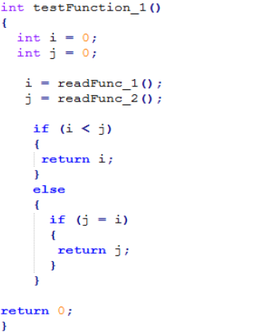
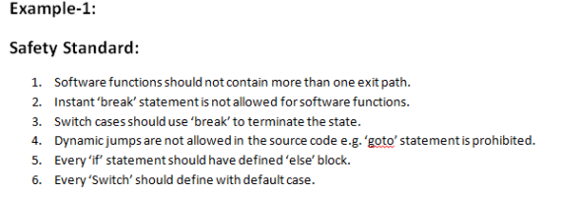
Static Analysis By Tool
Standard Compliance

Slide 30
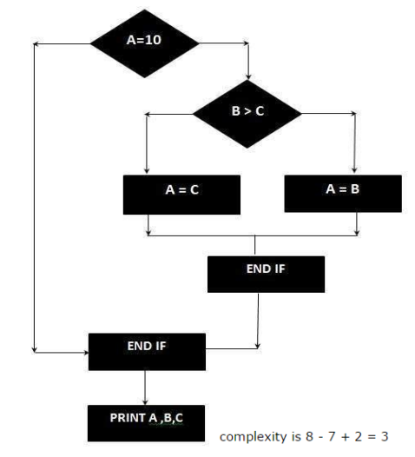
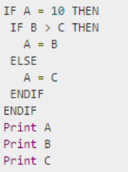
Static Analysis By Tool
Code Metric
Cyclomatic Code Complexity CC = E – N + 2P E = Number of Edges N = Number of Nodes in Graph (Shapes) P = Exit Paths

Slide 31
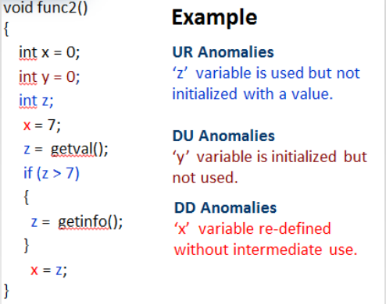
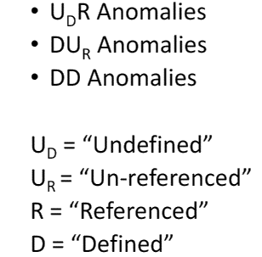
Static Analysis By Tool
Data Flow

Slide 32
Static Analyzer
HP Fortify
McCabe
LDRA
Lint Tools
Source Monitor
Parasoft
To calculate metrics such as cyclomatic complexity or nesting levels (which can help to identify where more testing may be needed due to increased risk).
To enforce coding standards.
To analyze structures and dependencies.
Help in code understanding.
To identify anomalies or defects in the code.

